Slide 1
Communications and Radar-Supported Transportation Operations and Planning (CAR-STOP)
Project 0-6877
TxDOT PM: Darrin Jensen
Research Supervisor: Chandra Bhat
Researchers: Joydeep Ghosh, Robert Heath, Junil Choi, Mohammed Eltayeb
Graduate RAs: Taewan Kim, Michael Motro, Rahi Kalantari, Preeti Kumari, Enoch Yeh, Anum Ali, Alice Chu, Subodh Dubey

Slide 2
Outline
Project motivation
Work description in detail
Q&A

Slide 3
Motivation

Slide 4
Project motivation
CRASHES ➔ Enormous cost to society
Cost almost $1 trillion!!!
Property damage
Productivity loss
Injury
Death
2,310,000
32,719
Injuries in TX
Death in TX
232,041
3,382
2013 injuries in US*
2013 death in US**
*: NHTSA, 2014
**: TxDOT, 2014

Slide 5
CAR-STOP approach
1
2
3
Multidisciplinary approach to improve CA/CW
Communication
and radar
technologies
Distributed
decision
making
MACHINE
LEARNING
WIRELESS
TRANSPORTATION
Transportation aspects

Slide 6
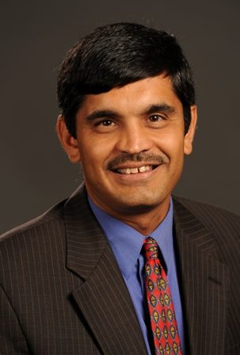

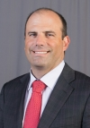
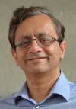
UT expertise for CAR-STOP
Chandra Bhat
Robert W. Heath
Smart transportation
Wireless communication
Dynamic vehicular environment
modeling
Driver psychology modeling
Driver habitats modeling
MmWave & V2X communications
Radar signal processing
Prototyping
Machine learning & BigDATA
Distributed decision making
Joydeep Ghosh

Slide 7
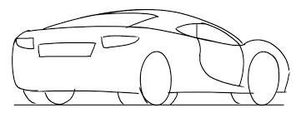
CAR-STOP at a glance
Which prior info?
How do we obtain info?
How do we use info?
IMPROVED
SAFETY
Exploit prior info
Driver´s behavior
Typical traffic condition
SAFE
Joint radar and communications
Waveform / hardware / antenna design
Security needed to prevent spoofing
Collision warning/avoidance algorithms
Smart combination of information
Distributed decision making

Slide 8
Project scope
Task 1
Task 2
Conceptual and Functional Framework for Integrating Communications and Radar
Developing Joint Automotive Radar and Communication at the mmWave Band
Task 3
Conduct Preliminary Tests
and Develop Concept of Operations (CONOPS)
Complete research plan for full development

Slide 9
Contributions Task 1

Slide 10
Task 1: Definition and contributions
1.1. Improved CW/CA for cars
Months 1-10
TASK 1
CONTRIBUTIONS
□ Improve trajectory prediction from prior information
Utilizes motion pattern
□ Evaluate CW capability using DSRC and simple warning system
Incorporates driver behavior & vehicular dynamics
Conceptual and functional framework for integrating communications and radar
1.2 Improved CW/CA for pedestrians and bicycles
Months 7-13
1.3. Dealing with uncertainty
Months 7-13

Slide 11
Subtask 1.1: Develop improved collision detection and avoidance algorithms for cars
Workpackage 1.1.1: Combining information from the communication and radar systems
Workpackage 1.1.2: Incorporating vehicular dynamics and driver behavior
- Vehicle CW/CA System
Collision Warning (CW)
Current State Estimation
Future Trajectory Prediction
Detect Potential Trajectory Conflict
Collision Avoidance (CA)

Slide 12
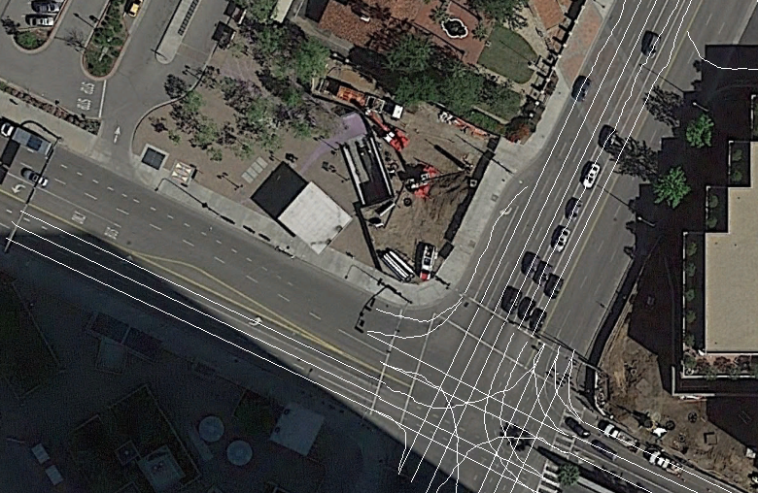
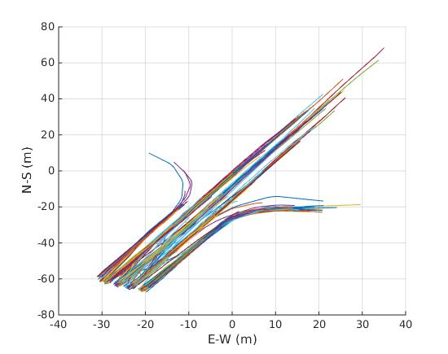

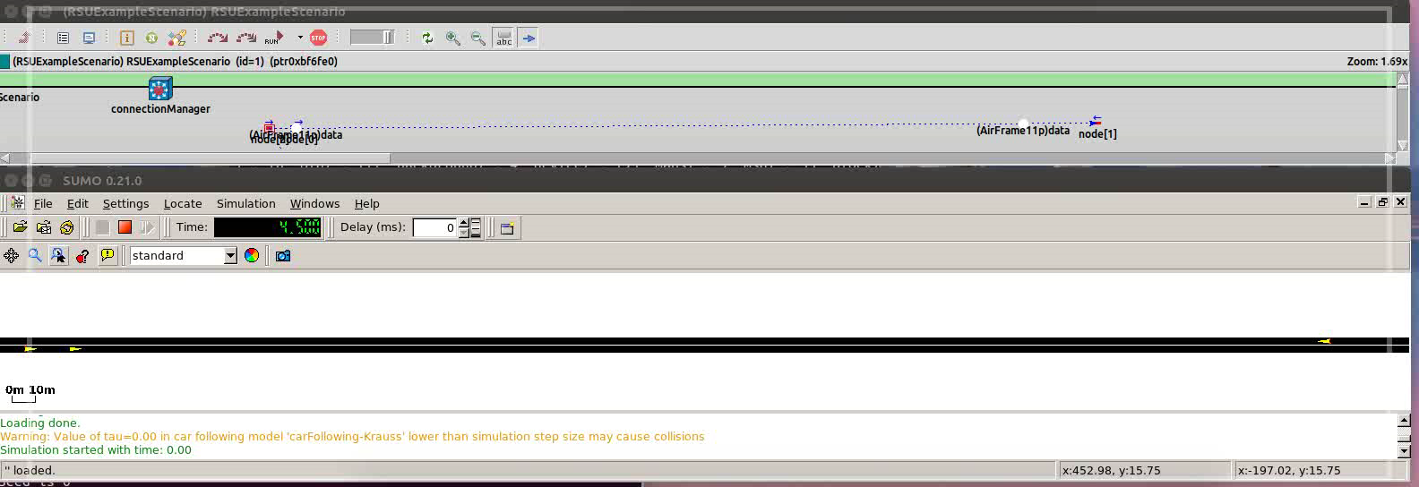
Data Acquisition
NGSIM

Slide 13
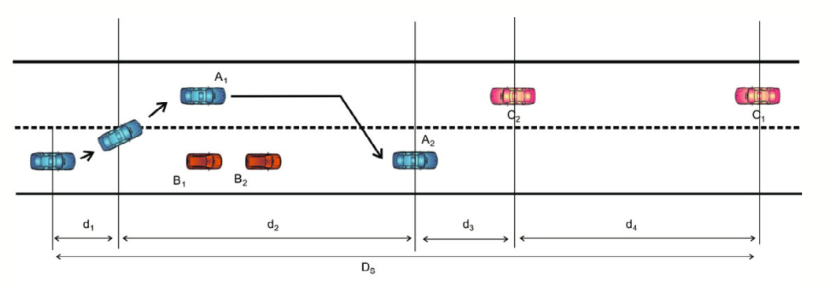

Vehicular ad-hoc network (VANET) simulations of overtaking maneuvers on two-lane rural highways (1.1.1)
Overtaking warning system: alerts driver if overtaking maneuver is unsafe
DSRC Communication
Range far enough to be reliable?
Can send enough information?
Noise in information?
Driver behavior
how fast to accelerate
How close to passed car
100mW
Normal DSRC protocol
Knowledge of driver behavior

Slide 14
Difficulty of future trajectory prediction
w/o Motion Pattern
Most vehicles’ trajectory
Hole
Crack
Vehicle direction
Current position
Utilize further information for better prediction
Motion Pattern: possible behavior of vehicle
Notes:
Example. Suppose there has been a hole in a road for a while.
Without any further information, trajectory prediction algorithm will give smooth curve for turning left.
However, most vehicles detour around the whole with unexpected curve.

Slide 15
Motion pattern clustering and classification
Different techniques used to cluster (group) the trajectories - EM (Expectation Maximization) - DTW(Dynamic Time Warping) - Map Based

Slide 16
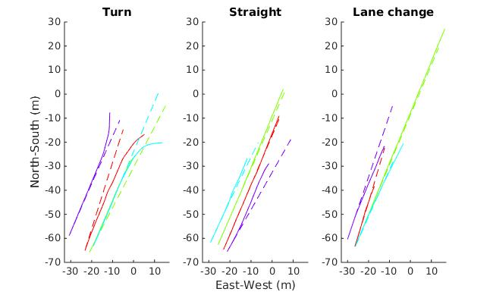
Physics-based Trajectory Prediction

Slide 17
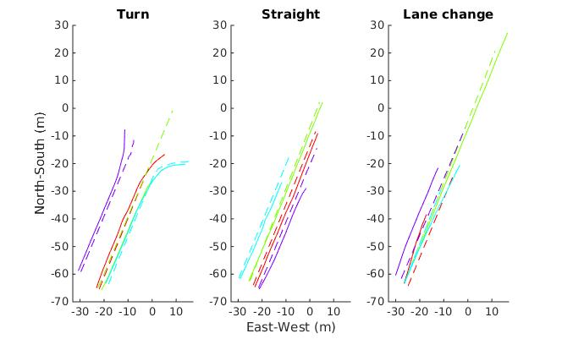
Learning-based Trajectory Prediction

Slide 18
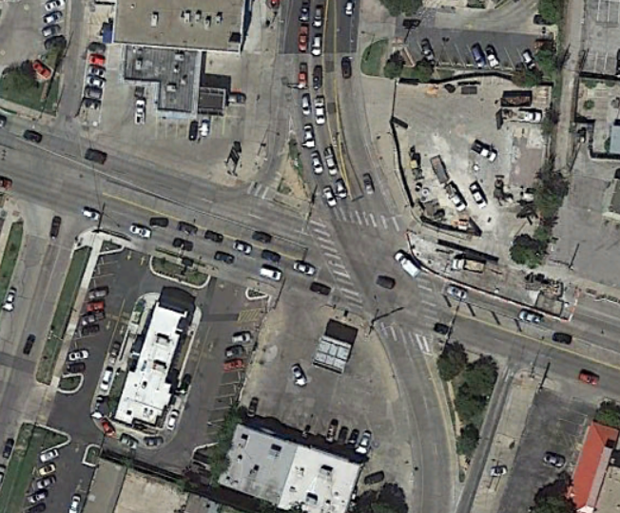
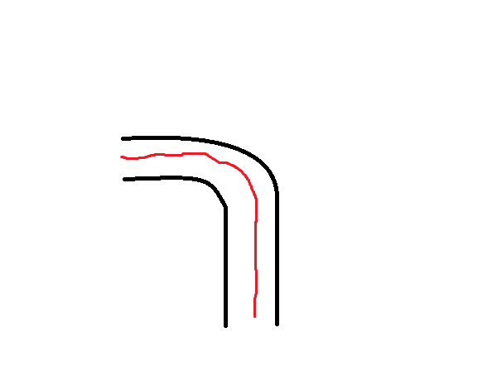
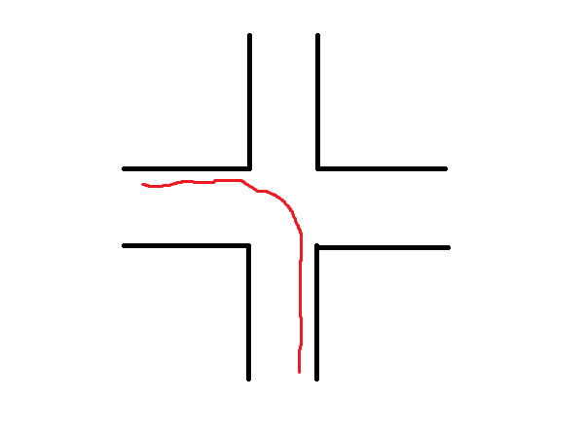
Future plans for trajectory prediction
Smart motion pattern/physics fusion
Gaussian process
Road–Motion connection
Many atypical roads – can’t get data for every road
Connect road characteristics to driver actions

Slide 19
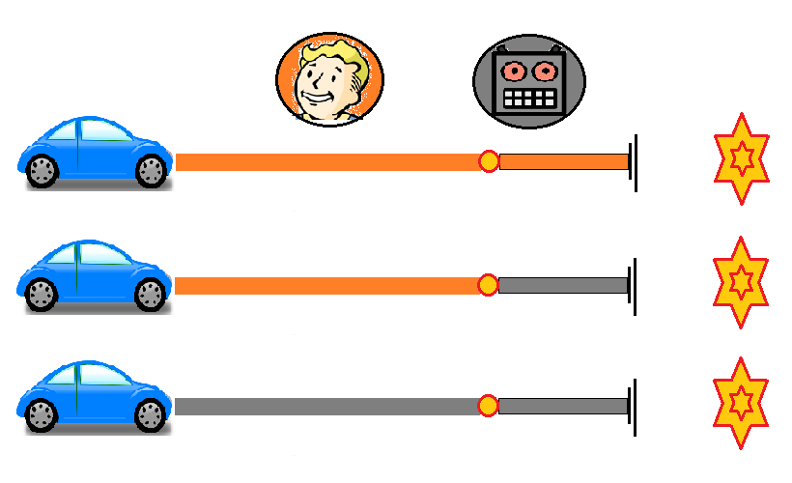
Future plans for collision avoidance
Warning
Takeover
Autonomous
Questions:
Can DSRC provide enough info to prevent collisions? (1.3.2)
mmWave?
Can pedestrians/cyclists be dealt with the same way? (1.2.1)
What about other autonomous cars? (1.3.3)

Slide 20
Contributions Task 2

Slide 21
Task 2: Definition and contributions
2.1. Develop a framework for joint mmWave communications and radar
Months 1-10
TASK 2
CONTRIBUTIONS
□ Make mmWave work for vehicles
□ Demonstrate radar using low frequency WiFi signals
□ Study joint communication and radar systems at mmWave
2.2. Optimizing the Joint Waveform to Meet Different Objectives
Months 7-13
Joint automotive radar and communication at the mmWave band
2.2. Incorporating Antenna Arrays
Months 7-13
2.2. Dealing with security issues
Months 7-13

Slide 22



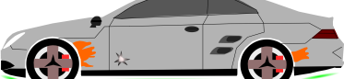
Background on radar and vehicular communications
Long, medium and short range radar with different applications
Vehicle to infrastructure
(V2I)
communication
Target Vehicle
Vehicle to vehicle (V2V)
communication
Long range
radar beam
Estimate range and
velocity from reflected signal
MmWave radars widely used in automotive safety applications
Expensive: automotive radar modules cost around $1,500
Easy to get spoofed compared to communication
Current V2X communications are based on WLAN standards
Safety applications possible: Forward collision warning, do not pass warning …
Maximum data rate of 27 Mbps
Communication or radar alone not enough for safety applications

Slide 23
Motivation for joint radar and communications at mmWave
possible 5G cellular bands
unlicensed spectrum
Automotive radar (24/26 GHz)
Automotive radar (76-81 GHz)
automotive radar
30 GHz
38-49 GHz
60 GHz
unlicensed
70-90 GHz
300 GHz
28 GHz
MmWave radio frequency spectrums are
Already adopted in automotive radar
Know-how exists among automotive suppliers
Already employed in latest WLAN applications
Low cost device production
Joint mmWave communication and radar systems
May build on existing mmWave wireless communication standards
Low cost / higher data rates / secure / increase penetration rate

Slide 24




Fundamentals on mmWave communication
directional beamforming
blockage
mmWave
base station
V2V communication beam
V2I communication
beam
MmWave communication is different
Severe signal attenuation / sensitivity to blockages
Large antenna arrays
Directional beamforming
Large bandwidth enables high data rates and high accuracy for radar
Knowledge on mmWave communication will guide joint radar & comm.

Slide 25
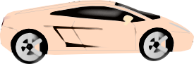
Making mmWave work for vehicles
different beam widths
beam pointing error
A
B
Choosing the beamwidth in joint radar-communication mmWave systems
Account for mobility and beam pointing error*
Optimum beam is “pointy” but not too narrow
*V. Va and R. W. Heath Jr., “Basic relationship between channel coherence time and beamwidth in vehicular channels,” to appear in VTC-Fall, Sept. 2015.

Slide 26
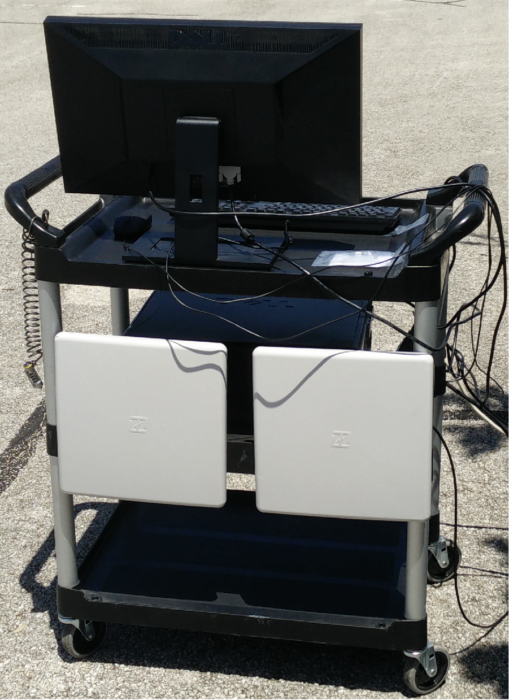
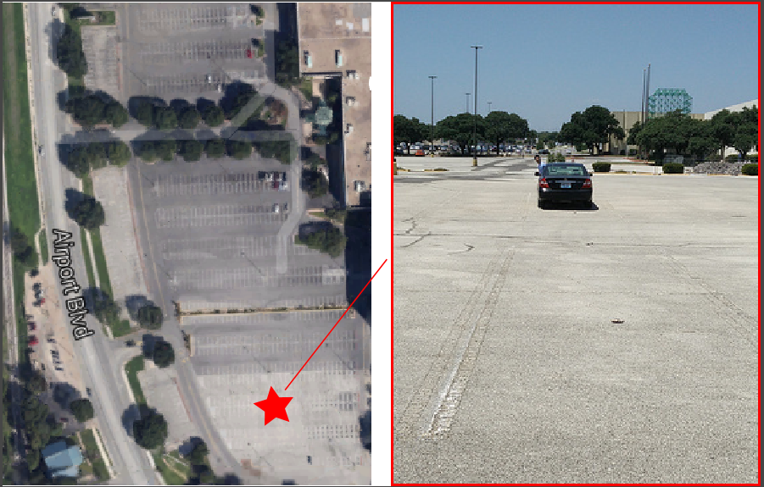
Radar testbed using low-frequency WLAN signals
2002 Toyota Camry
Comm.-RADAR
link setup
Location of
measurements
Real-time implementation and fields tests
Leverage existing National Instruments hardware
Exploit sub-mmWave WLAN signals as a proof-of-concept for mmWave
Show that it is possible to use a communication signal for ranging
Sub-meter accuracy achieved in single target setting
More advanced algorithms under study to improve performance
Alternative radar solution with lower cost
Figure 2: Map and picture of measurement location in vacant parking lot. Vehicle used during testing was a 2002 Toyota Camry.

Slide 27
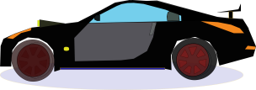
Initial framework for mmWave joint communication and radar
Build from the recently released consumer mmWave WLAN standard
Motivates a common radar and communication standard at the mmWave band
Lower cost since WLAN chips are cheap and high volume
Developed mmWave WLAN framework works well as a long range radar*
Leverages WLAN receiver algorithms for radar parameter estimation
Achieved desired accuracy for range and velocity estimation
* Preeti Kumari, Nuria González Prelcic and Robert W. Heath, Jr, “Investigating the IEEE 802.11ad Standard for Millimeter Wave Automotive Radar,” to appear in VTC-Fall, Sept. 2015.

Slide 28
Subtask 2.1: Future Plans
Making mmWave work for vehicles
Understand the overhead of beam alignment
Exploit radar/DSRC to reduce beam alignment overhead
Incorporate these results to radar performance evaluation
Demonstrate radar using low-frequency WLAN signals
Conduct a head-to-head comparison with mmWave radar
Joint mmWave radar and communication
Study trade-off between radar and communication using mmWave WLAN standard
Optimize the framework for better radar performance

Slide 29
Subtask 2.2: Optimizing the Joint Waveform
Adapt waveform with environmental situation
Rural / urban area
Vehicle / communication traffic
FUTURE PLANS
Define different working scenarios
Bicycle near a car / several cars ahead, avoid collision with pedestrian, etc.
Waveform design is related to limited resources
Bandwidth, power, time
FUTURE PLANS
Design optimization strategies
Define cost functions and constraints
Optimize radar and communication parameters depending on scenarios

Slide 30
Subtask 2.3: Incorporating antenna arrays
Antenna arrays are important to
Radar systems
MmWave communication systems
FUTURE PLANS
Design antenna architecture for joint radar & comm.
Investigate a unified architecture for radar and comm.
Performance metric for radar and communication may conflict
COMM: Maximize receive power
RADAR: Better target detection
FUTURE PLANS
Design beamforming algorithm for joint radar & comm.
Radar with hybrid beamforming never explored before

Slide 31
Subtask 2.4: Dealing with security issues
Connected vehicles vulnerable to cyber attacks
Recent demonstration on Jeep hacking
Lack of privacy on connected vehicles may lead to “Big Brother”
FUTURE PLANS
Physical layer security with large antenna arrays
MmWave with large number of antennas may allow additional security
Using antenna subsets to prevent eavesdropping
Current security/privacy protocols based on digital signature
Large number of digital key pairs should be changed often
Digital key can be breached
FUTURE PLANS
Analysis of security in automotive case
Study the fundamental limit of security using subsets
Study the impact of secured beamforming on radar

Slide 32
Future Plans Task 3

Slide 33
Task 3: Definition and work plan
TASK 3
3.1. Preliminary tests with real data
Months 8-13
FUTURE PLANS
□ Collect real data with prototyping
□ Optimize developed algorithms/systems with real data
Conduct Preliminary Tests and Develop Concept of Operations
3.2. Asses benefits of proposed system and develop CONOPS
Months 9-15
FUTURE PLANS
□ Asses benefits of proposed system
□ Develop CONOPS

Slide 34
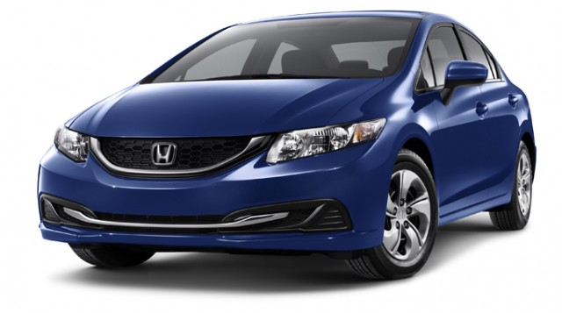
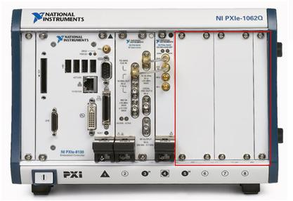
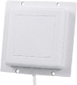
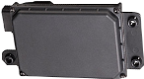
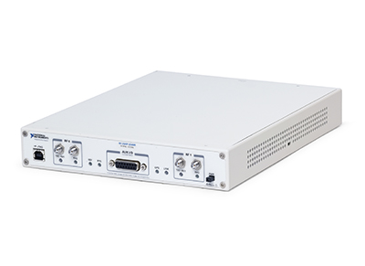
Prototyping plan
National Instruments
PXI Chassis Interfaces with USRP-RIO & ESR
Test using IEEE 802.11p
Redundant radar
Target information sharing
ESR forward target cross-checking for validation
National Instruments
USRP-RIO w/ 5.8 GHz
RF, 802.11p PHY+MAC
RX
TX
RX
L-COM 23-dBi HG4958-23P Patch
- 2 receive (RX)
- 1 transmit (TX)
Delphi ESR 2.5 77 GHz RADAR
Collect real data with prototyping (3.1.1)
Optimize developed algorithms/systems with real data (3.1.2)

Slide 35

Subtask 3.1 Environments to Consider (in and around UT Austin)
Where
Traffic Volume of Road User Mix: Cars, Heavy Vehicles/Buses, Motorcycles, Pedestrians, Bicyclists
Routes: Intersections (Four-Way, T, Y, Traffic Circle, Atypical), Non-Intersections, Construction Sites
Interactions with Non-Connected Vehicles
High-Incident Areas: Focus on Frontal Collision Scenarios
Roadway Alignment: Straight, Curved (Curve Radius: ≥ 500, ≥ 250, ≥ 125)
Speed Limits: < 20mph, 20-45 mph, 45-60 mph, > 60 mph

Slide 36

Subtask 3.1 Environments to Consider (in and around UT Austin)
When
Day of Week: Weekday, Weekend
Time of Day: AM Off-Peak, AM Peak, PM Off-Peak, PM Peak, Evening
Weather Conditions: Clear, Cloudy, Rainy

Slide 37

Subtask 3.1 Environments to Consider (in and around UT Austin)
How
Communication Technology to Consider: DSRC, mmWave Communication
Sensing Technology to Consider: Radar (LRR, SRR), Lidar, GPS, Cameras, Ultrasound
Data to Collect: Accuracy and resolution of measured parameters for sensing, probability of detection and false alarm rate for sensing, bit error rate and throughput for communication, range of operation

Slide 38
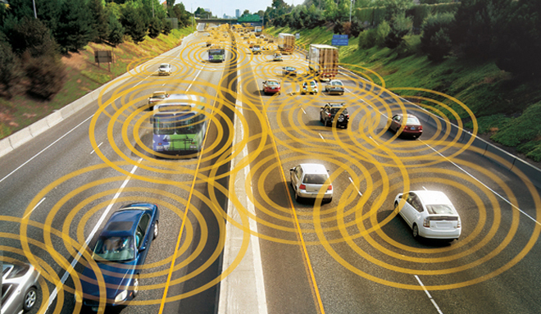
Thank You
Questions, Comments or Suggestions?

